Slide 1
Ulcer, Sinus& Fistula
By: Dr. IBRAHIM FALIH NOORI

Slide 2
Ulcer is defined as persistent breach in the continuity of skin surface or mucous membrane due to molecular death of cell usually with superadded infection.

Slide 3
1- Margin: is the line of junction or demarcation between the ulcerating and intact skin. Types of margin could be:
Irregular and ill-defined margin in growing and spreading ulcer
Regular and well-defined white margin in chronic non-healing ulcer
Regular and well-defined margin with characteristic three zone in healing ulcer

Slide 4
2-Edge: is the part of ulcer which connects floor to the margin. Different edges are:
Slopping edge: seen in healing ulcer and venous ulcer.
Undermined edge: seen in tuberculous ulcer.
Punched out ulcer: seen in syphilitic ulcer and trophic ulcer.
Raised and beaded edge : seen in rodent ulcer of basal cell carcinoma.
Everted edge: seen in squamous cell carcinoma and in any carcinomatous ulcer.

Slide 5
Ulcer Edges

Slide 6
3- Floor: is the exposed part of an ulcer.
Floor of the ulcer may contain granulation tissue, discharge or slough
granulation tissue: is highly cellular and vascular tissue formed as a result of body response to control infection and promote healing. It maybe healthy (red), unhealthy ( pale) and hypertrophic or exuberant.
Discharge: (serous, sanguineous, purulent, greenish, yellowish or sulphur granules).
Slough: is moist dead tissue which is not yet separated from the floor of ulcer.
4-Base : is the part on which ulcer rests. It may be bone or soft tissue.

Slide 7
Granulation Tissues

Slide 8
Different Discharges in an ulcer
Serous : in healing ulcer
Purulent : in infected ulcer.
Staphylococci: yellowish and creamy.
Streptococci: bloody and opalescent.
Pseudomonas : greenish color due to pseudocyanin
Sero- purulent.
Sero- sanguinous
Serous with sulphur granules: actinomycosis.
Yellowish: Tuberculous ulcer.

Slide 9
Classifications of Ulcer.
Clinical Classification.
Pathological Classification.
Etiological Classification.

Slide 10
1- Clinical Classification
Spreading Ulcer: surrounded skin is inflamed, floor is covered by slough, purulent discharge and no evidence of granulation tissue.
Healing ulcer: surrounding skin not inflamed, floor covered with granulation tissue, slight serous discharge.
Callous ulcer: pale granulation tissue,induration at the base and show no tendency towards healing.

Slide 11
2- Pathological Classification
Non-specific ulcer: like traumatic ulcer,arterial ulcer, venous ulcer, trophic ulcer, diabetic ulcer, ulcer due to anemia and malnutrition and miscellaneous ulcer.
Specific ulcer: like tuberculous ulcer,syphlitic ulcer, actinomycosis ulcer and Meleneys ulcer.
Malignant ulcer: sequamous and carcinomatous ulcer, rodent ulcer, and melanotic ulcer.

Slide 12
Wagner‘s grading/ classification of ulcer
Grade 0- pre- ulcerative lesion/ healed ulcer.
Grade 1- superficial ulcer.
Grade 2- ulcer deeper to subcutaneous tissue exposing the soft tissues or bone.
Grade 3- formation underneath / osteomyelitis.
Grade 4- gangrene of part of tissue/ limb/ foot.
Grade 5- gangrene of entire one area/ foot.

Slide 13
Venous Ulcer
Ischemic Ulcer

Slide 14
Trophic Ulcer
Diabetic Ulcer

Slide 15
Squamous cell carcinoma
Basal Cell carcinoma

Slide 16
Melanotic Ulcer
Marjolin Ulcer

Slide 17
The natural history of ulcer consists of 3 phases.
Stage of extension: ulcer is spreading, floor is covered by slough, purulent or bloody discharge, the edges are inflamed and edematous.
Stage of transition: separation of slough, red granulation, serous discharge, appearance of granulation tissue, base is less indurated.
Stage of healing: granulation tissues becomes fibrous tissue, spread of epithelium across the lesion, formation of the scar.

Slide 18
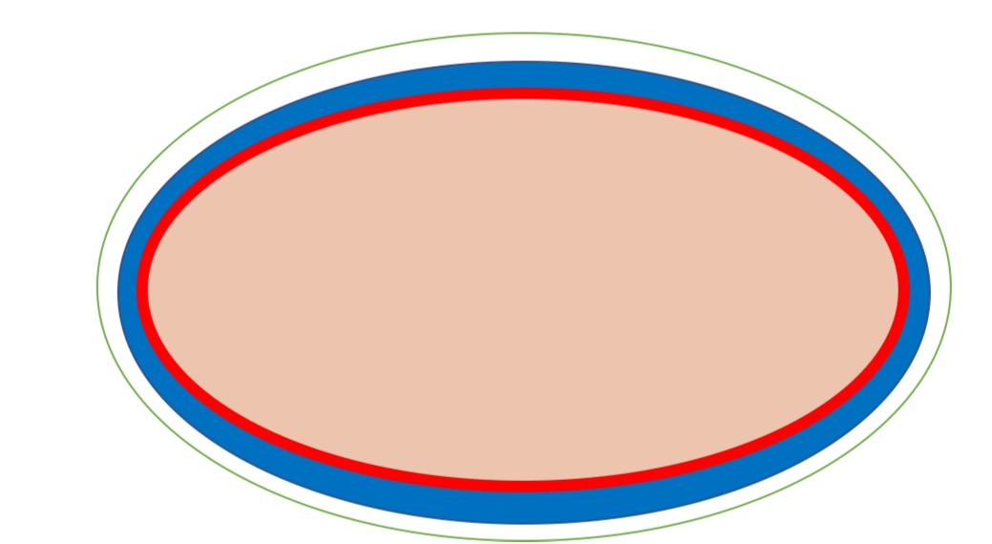
Margins of Healing Ulcer
1- outer white zone due to fibrosis in subcutaneous tissue as the ulcer heals.
2- Central blue zone of thin multilayered non cornified epithelium growing over granulation tissue from the periphery.
3- Inner red zone of single layer of growing epithelium cell which appeared red due to granulation tissue.

Slide 19
Clinical examination of an ulcer.
History
Mode of onset
Duration
Pain – its time of onset , progress, severity.
Discharge from ulcer.
History suggestive of associated diseases/ treatment history.

Slide 20
Local examination of ulcer
Inspection
Site of ulcer.
Size and shape of ulcer.
Number of ulcer.
Margin whether regular , irregular, well-defined/ ill-defined.
Edge of ulcer.
Floor of ulcer.
Discharge from the ulcer bed.
Surrounding areas.
Inspection of the entire part/ limb

Slide 21
II . Palpation
Tenderness and temperature over the edge, base and margin.
Edge and margin palpation for induration.
Palpation of the base for induration and fixity.
Depth of the ulcer.
Bleeding on palpation
Palpation of deeper structures.
Examination of adjacent joint for mobility.
Examination of regional lymph node is essential.
Examination of peripheral pulses is also essential.
Examination of varicosed veins in standing position.

Slide 22
Systemic examination
Examination of cardiovascular system for evidence of heart failure , murmur and atrial fibrillation.
Examination of the abdomen for splenomegaly, hepatomegaly and ascites.
Examination of spine for any gibbus, paraspinal spasm, movement .
Examination of neurological system like sensation and muscle power.

Slide 23
Investigations for an ulcer.
Study of discharge : culture and sensitivity, AFB study, cytology.
Edge biopsy: Biopsy is taken from the edge because edge contains multiplying cells.
X – ray of the part to look for periostitis/ osteomyelitis.
FNAC of the lymph node.
Chest X – ray, Mantoux test is suspected case of tuberculous ulcer.

Slide 24
Management of an Ulcer
Cause should be found and treated.
Correct the deficiencies like anemia, protein and vitamin deficiencies.
Transfuse blood if required,
Control of pain.
Investigate properly.
Control of infection and give rest to the part.
Care of the ulcer by debridement, ulcer cleaning,and dressing is done.
Remove the exuberant granulation tissue.
Topical antibiotics for infected ulcer only.
Once granulate, defect is closed with secondary suturing, skin graft, flaps.

Slide 25
Causes of chronic non – healing Ulcer
Recurrent infection
Trauma.
Absence of rest.
Poor blood supply and malnutrition
Hypoxia.
Edema of the area.
Loss of sensation.
Malignancy and immunosuppression.
Specific cause like tuberculosis
Fibrosis.
Periostitis or osteomyelitis of the underlying bone.

Slide 26
Investigations
General -CBC: Hb, WBC and differential for anemia and chronic infection.
-Blood sugar, Blood urea, Urine for sugar and protein
-CXR & ECG
Specific -study of discharge, swab for smear , culture and sensitivity, AFB study, cytology.
- 4 quadrants edge biopsy
-X-ray of part to look for periostitis/osteomyelitis. The
-FNAC of Lymph nodes.
-Doppler study.

Slide 27
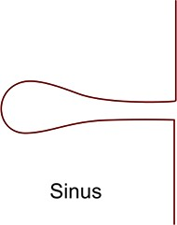
SINUS: Blind track lined by granulation tissue leading from epithelial surface down into the tissues. Latin: Hollow (or) a bay
Causes
Congenial: preauricular sinus.
Acquired : pilonidal sinus, median mental sinus, actinomycosis, chronic osteomylitis.

Slide 28
Preauricular Sinus
Pilonidal Sinus

Slide 29
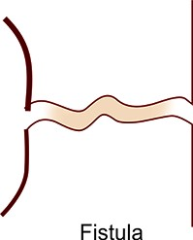
FISTULA:
ABNORMAL communication between lumen of one viscus and lumen of another (INTERNAL FISTULA)
(or)
between lumen of one hollow viscus to the
exterior (EXTERNAL FISTULA)
(or)
between any two vessels
Fistula: latin: flute or a pipe

Slide 30
CAUSES
CONGENITAL
Branchial fistula
Tracheo-esophageal fistula
Umbilical fistula
Congenital AV fistula
Thyroglossal fistula
ACQUIRED
Traumatic
Inflammatory
Malignancy
Iatrogenic

Slide 31
FISTULA
EXTERNAL
Orocutaneous
Enterocutaneous
Appendicular
Thyroglossal
Branchial
INTERNAL
Tracheo-esophageal
Colovesical
Rectovesical
AVF
Cholecystoduodenal

Slide 32
CLINICAL FEATURES
Usually asymptomatic but when infected manifest as-
Recurrent/ persistent discharge.
Pain.
Constitutional symptoms if any deep seated origin.
Raised indurated edge, indurated base.
Often sprouting granulation tissue over the sinus opening.
Bone thickening in osteomylitis.

Slide 33
Thyroglossal Fistula
Fistula in Ano

Slide 34
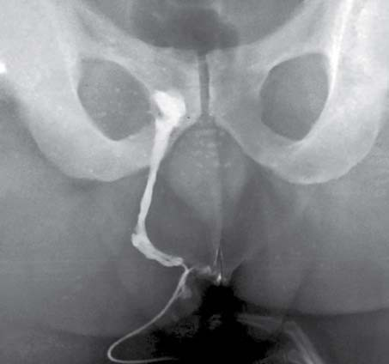
INVESTIGATIONS
CBP, Blood sugar, Blood urea and s. Protein.
Discharge for C/S , AFB, cytology, Gram staining.
Fistulogram/ sinogram.
BIOPSY from edge
Chest X- ray, X-RAY of the part to rule out osteomyelitis , foreign body.
MRI
CT Sinusogram
Probing
DRE and proctoscopy in fistula in ano

Slide 35
Treatment
Treat the cause .
Excision of sinus or fistula.
Always specimen should be sent for histology.

Slide 36
Causes for persistence of sinus (or) fistula
Foreign body. e.g., suture material
Radiation
Infection ( e.g.TB, and presence of necrotic tissue underneath. e.g.,sequestrum
Epithelialisation (or) Endothelisation of the track. e.g., AVF
Neoplasm
Distal obstruction. e.g., faecal (or) biliary fistula
Sepsis & Steroid
*Always remember FRIENDS

